Slide 1
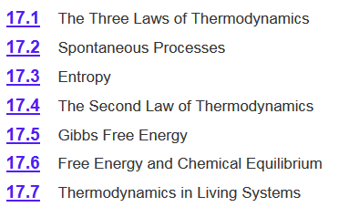
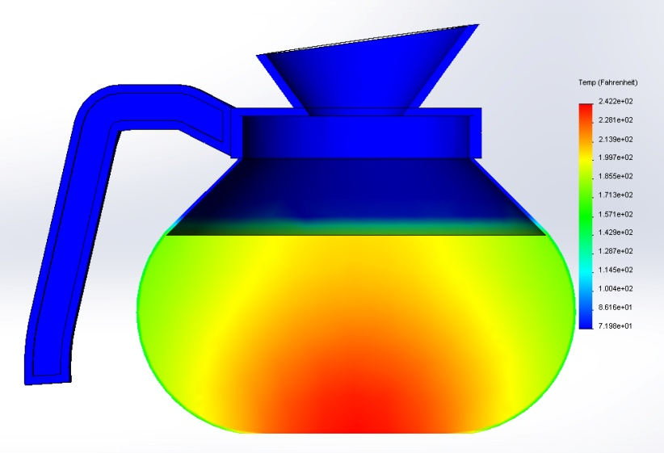
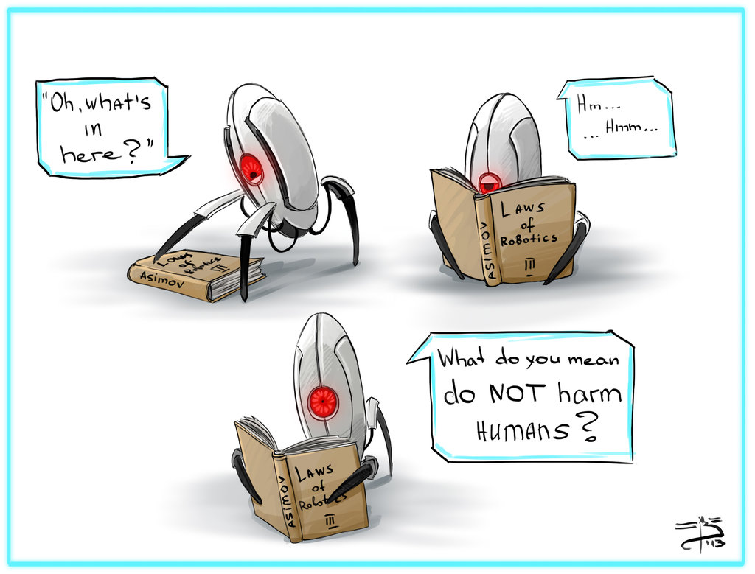
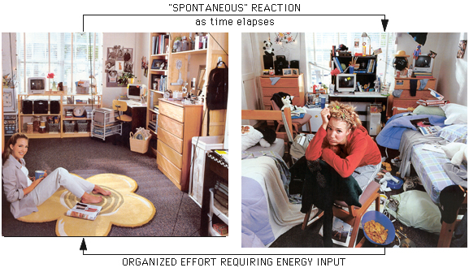
Chapter 17

Slide 2
Gibbs Free Energy
For a constant temperature and constant pressure process:
-TΔS_{univ} = ΔH_{sys} - TΔS_{sys}
ΔG = ΔH_{sys} - TΔS_{sys}
Gibbs free energy (ΔG)- Can be used to predict spontaneity.
ΔG < 0 The reaction is spontaneous in the forward direction.
−ΔG = -T(+ΔS_{univ})
ΔS_{univ} > 0
ΔG > 0 The reaction is nonspontaneous as written. The
reaction is spontaneous in the reverse direction.
+ΔG = -T(-ΔS_{univ})
ΔS_{univ} < 0
ΔG = 0 The reaction is at equilibrium.
ΔG = -T(ΔS_{univ}) = 0
ΔS_{univ} = 0

Slide 3
Gibbs Free Energy
ΔG = ΔH - TΔS
If you know ΔG for reactants and products then you can calculate if a reaction is spontaneous.
If you know ΔG for two reaction then you can calculate if the sum is spontaneous.
If you know ΔS, ΔH and T then you can calculate spontaneity.
Can predict the temperature when a reaction becomes spontaneous.
If you have ΔH_{vap} or ΔH_{fus} and ΔS you can predict boiling and freezing points.
If you have ΔH_{vap} or ΔH_{fus} and T you can predict the entropy change during a phase change.
Can predict equilibrium shifts.

Slide 4
Chapter 17

Slide 5
Free Energy and Equilibrium
The standard free-energy of reaction (ΔG⁰ ) is the free-energy change for a reaction when it occurs under standard-state conditions.
rxn
aA + bB cC + dD
ΔG⁰
=
Σ
nΔG⁰ (products)
-
Σ
mΔG⁰ (reactants)
rxn
f
f
ΔG° < 0 favors products spontaneously
ΔG° > 0 favors reactants spontaneously
Does not tell you it will go to completion!
ΔG° _{fwd}
aA + bB cC + dD
ΔG° _{fwd} = -ΔG° _{rev}
ΔG° _{rev}
The value of ΔG° calculated under the standard conditions characterizes the “driving force” of the reaction towards equilibrium.

Slide 6
Free Energy and Equilibrium
ΔG° = -R T lnK
equilibrium constant
(K_{p}, K_{c}, K_{a}, K_{sp}, etc.)
standard free-energy
(kJ/mol)
gas constant
(8.314 J/Kmol)
temperature
(K)
Arguably most important equation in chemical thermodynamics!
It allows us to calculate the extent of a chemical reaction if its enthalpy and entropy changes are known.
The changes in enthalpy and entropy can be evaluated by measuring the variation of the equilibrium constant with temperature.
This relationship is only valid for the standard conditions, i.e. when the activities of all reactants and products are equal to 1.

Slide 7
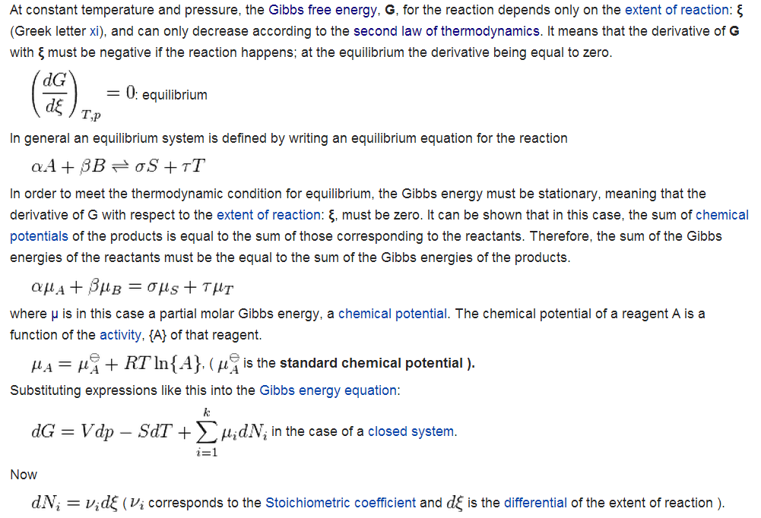
Derivation
http://en.wikipedia.org/wiki/Chemical_equilibrium#Thermodynamics

Slide 8
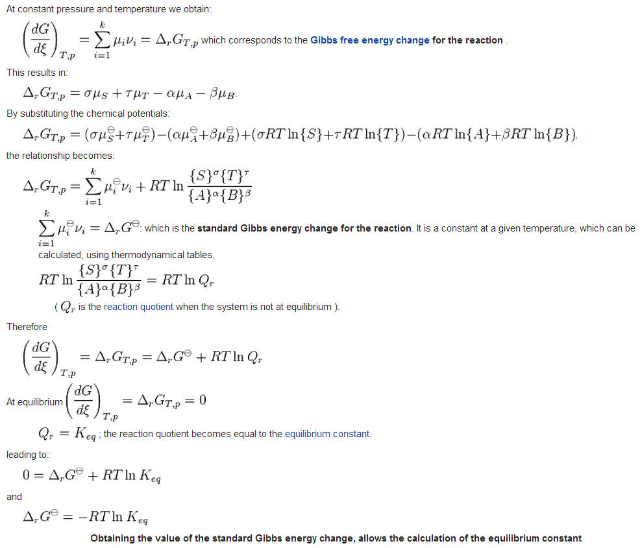

Slide 9
Free Energy and Equilibrium
ΔG° = -R T lnK
R is constant so at a given temperature:
ΔG⁰(kJ)
K
Significance
200
9x10⁻³⁶
Essentially no forward reaction; reverse reaction goes to completion
100
3x10⁻¹⁸
50
2x10⁻⁹
10
2x10⁻²
1
7x10⁻¹
Forward and reverse reactions proceed to same extent
0
1
FORWARD REACTION
REVERSE REACTION
-1
1.5
-10
5x10¹
-50
6x10⁸
-100
3x10¹⁷
Forward reaction goes to completion; essentially no reverse reaction
-200
1x10³⁵

Slide 10
Using ΔG° and K
Using the table of standard free energies, calculate the equilibrium constant, K_{P}, for the following reaction at 25 °C.
2HCl(g) H₂(g) + Cl₂(g)
ΔG⁰
=
Σ
nΔG⁰ (products)
-
Σ
mΔG⁰ (reactants)
rxn
f
f
ΔG⁰_{rxn} = [1(0) + 1(0)] - [2(−95.3 kJ/mol)]
ΔG⁰_{rxn} = 190.6 kJ/mol
Non-spontaneous!
Favors reactants!
ΔG° = -R T ln K
From appendix 3:
H₂(g) ΔG°_{f} = 0 kJ/mol
Cl₂(s) ΔG°_{f} = 0 kJ/mol
HCl(g) ΔG°_{f} = -95.3 kJ/mol

Slide 11
Using ΔG° and K
Using the table of standard free energies, calculate the equilibrium constant, K_{P}, for the following reaction at 25 °C.
2HCl(g) H₂(g) + Cl₂(g)
ΔG⁰
=
Σ
nΔG⁰ (products)
-
Σ
mΔG⁰ (reactants)
rxn
f
f
ΔG⁰_{rxn} = [1(0) + 1(0)] - [2(−95.3 kJ/mol)]
ΔG⁰_{rxn} = 190.6 kJ/mol
Non-spontaneous!
Favors reactants!
ΔG° = -R T ln K
190.6 kJ/mol = − (8.314 J/K·mol)(25°C) ln K_{P}
correct units
190.6 kJ/mol = − (8.314 x 10⁻³ kJ/K·mol)(298 K) ln K_{P}
K_{P} = 3.98 x 10⁻³⁴
Favors reactants!

Slide 12
17.6
Using data listed in Appendix 3, calculate the equilibrium constant (K_{P}) for the following reaction at 25°C:
2H₂O(l) 2H₂(g) + O₂(g)
ΔG°_{rxn} = [2ΔG°_{f}(H₂) + ΔG°_{f}(O₂)] - [2ΔG°_{f}(H₂O)]
= [(2)(0 kJ/mol) + (0 kJ/mol)] - [(2)(-237.2 kJ/mol)]
= 474.4 kJ/mol
Bonus: What is the K_{p} for the reverse reaction?
2H₂(g) + O₂(g) 2H₂O(l)
lnK_{p(fwd)} = -lnK_{p(rev)}
ΔG°_{rxn} = -474.4 kJ/mol
or 1/K_{p(fwd)} = K_{p(rev)}

Slide 13
17.7
In Chapter 16 we discussed the solubility product of slightly soluble substances. Using the solubility product of silver chloride at 25°C (1.6 x 10⁻¹⁰), calculate ΔG° for the process
AgCl(s) Ag⁺(aq) + Cl⁻(aq)
K_{sp} = [Ag⁺][Cl⁻] = 1.6 x 10⁻¹⁰
ΔG° = -R T lnK
ΔG° = -(8.314 J/K·mol) (298 K) ln (1.6 x 10⁻¹⁰)
= 5.6 x 10⁴ J/mol
= 56 kJ/mol
Favors reactants.
Not very soluble!

Slide 14
Free Energy and Equilibrium
ΔG° = -R T lnK
ΔG°
-
Rearrange:
ln K =
R T
ΔH - TΔS
Substitution:
-
ln K =
R T
ΔG = ΔH - TΔS
ΔH TΔS
-
Rearrange:
ln K =
+
R T
R T
ΔH
1
ΔS
( )
-
ln K =
+
R
T
R

Slide 15
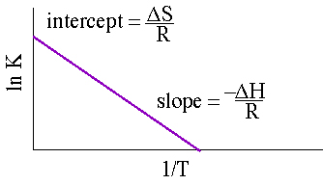
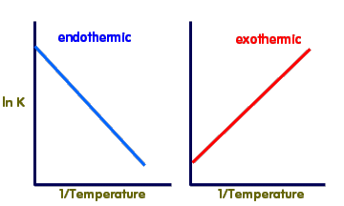
Free Energy and Equilibrium
ΔG° = -R T lnK
Measure equilibrium with respect to temperature:
ΔG°
-
Rearrange:
ln K =
R T
ΔH - TΔS
Substitution:
-
ln K =
R T
ΔG = ΔH - TΔS
ΔH TΔS
-
Rearrange:
ln K =
+
R T
R T
ΔH
1
ΔS
( )
-
ln K =
+
R
T
R
y = m • x + b

Slide 16
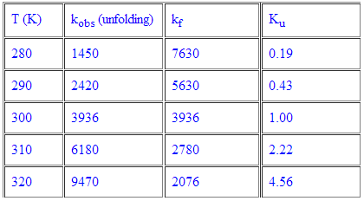

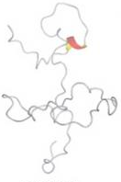
Free Energy and Equilibrium
Find the ΔS and ΔH of the following:
k_{obs}
k_{f}
A B
rate_{A→B} = k_{obs} [A]
rate_{B→A} = k_{f} [B]
At equilibrium:
rate_{A→B} = rate_{B→A}
k_{obs} [A] = k_{f} [B]
k_{obs}
[B]
=
=
K_{u}
k_{f}
[A]

Slide 17
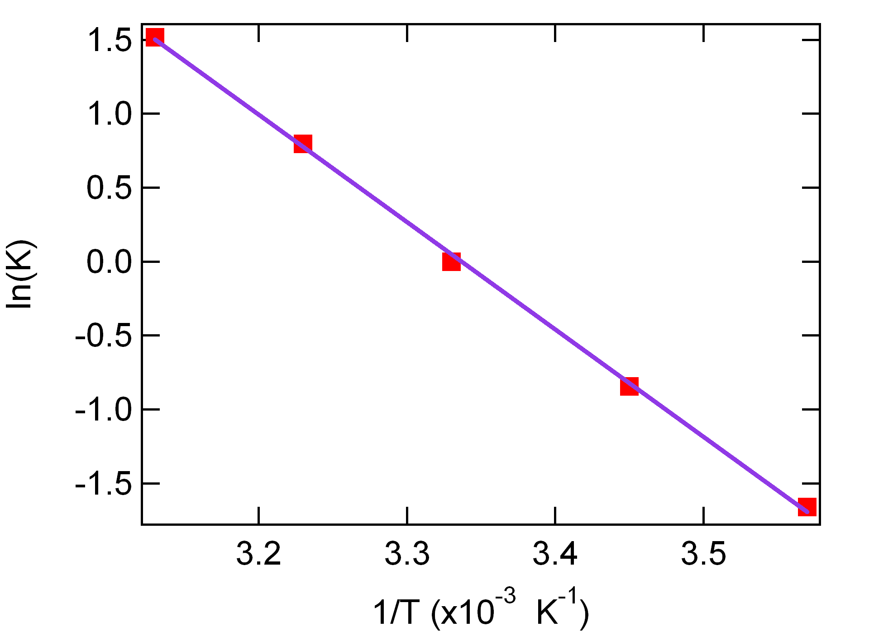
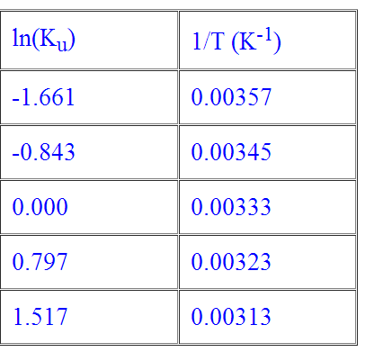
Free Energy and Equilibrium
Find the ΔS and ΔH of the following:
k_{obs}
k_{f}
ΔS
ΔH° = 60 kJ/mol
R
ΔS° = 200 J/Kmol
Slope = -7261.1 K
-
ΔH
R

Slide 18
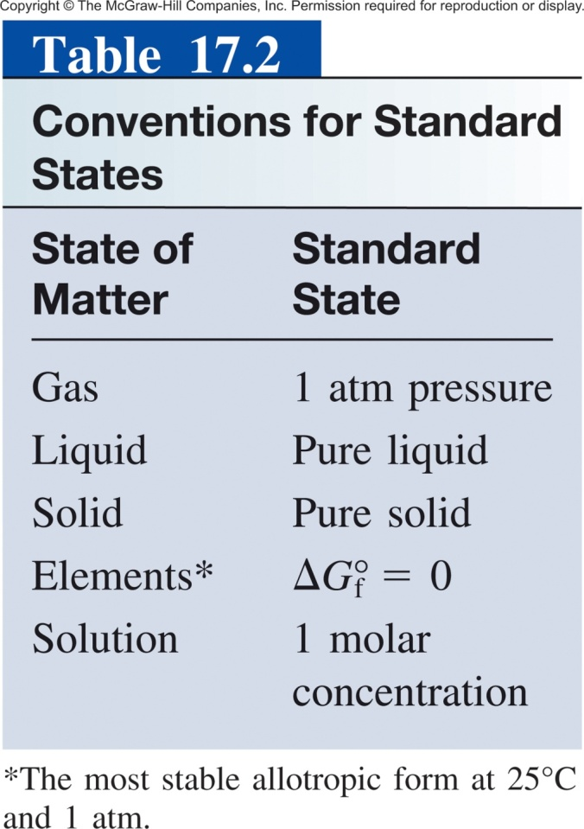
ΔG° vs ΔG
You have already delta ΔG°, ΔS° and ΔH° in which the ° indicates that all components are in their standard states.
Definition of “standard”:
Even if we start a reaction at standard conditions (1 M) the reaction will quickly deviate from standard.
ΔG° indicates whether reactants or products are favored at equilibrium.
ΔG at any give time is used to predict the direction shift to reach equilibrium.
If a mixture is not at equilibrium, the liberation of the excess Gibbs free energy (ΔG) is the “driving force” for the composition of the mixture to change until equilibrium is reached.
*There is no "standard temperature", but we usually use 298.15 K (25° C).

Slide 19
Free Energy and Equilibrium
At equilibrium:
ΔG° = -R T ln K
At any time:
ΔG = ΔG° + R T ln Q
reaction quotient
standard free-energy
(kJ/mol)
temperature
(K)
non-standard free-energy
(kJ/mol)
gas constant
(8.314 J/Kmol)
The sign of ΔG tells us that the reaction would have to shift to the left to reach equilibrium.
ΔG < 0, reaction will shift right
ΔG > 0, reaction will shift left
ΔG = 0, the reaction is at equilibrium
The magnitude of ΔG tells us how far it has to go to reach equilibrium.

Slide 20
Free Energy and Equilibrium
ΔG = ΔG° + R T ln Q
reaction quotient
standard free-energy
(kJ/mol)
temperature
(K)
non-standard free-energy
(kJ/mol)
gas constant
(8.314 J/Kmol)
If Q/K < 1, then ln Q/K < 0; the reaction proceeds to the right (ΔG < 0)
If Q/K > 1, then ln Q/K > 0; the reaction proceeds to the left (ΔG > 0)
If Q/K = 1, then ln Q/K = 0; the reaction is at equilibrium (ΔG = 0)

Slide 21
Another Example
For the following reaction at 298 K:
H₂(g) + Cl₂(g) → 2 HCl(g)
Given:
From appendix 3:
H₂ = 0.25 atm
Cl₂ = 0.45 atm
HCl = 0.30 atm
H₂(g) ΔG°_{f} = 0 kJ/mol
Cl₂(s) ΔG°_{f} = 0 kJ/mol
HCl(g) ΔG°_{f} = -95.3 kJ/mol
Which way will the reaction shift to reach equilibrium?
ΔG = ΔG° + R T ln Q
constant
calculate
calculate
given

Slide 22
Another Example
For the following reaction at 298 K:
H₂(g) + Cl₂(g) → 2 HCl(g)
Given:
From appendix 3:
H₂ = 0.25 atm
Cl₂ = 0.45 atm
HCl = 0.30 atm
H₂(g) ΔG°_{f} = 0 kJ/mol
Cl₂(s) ΔG°_{f} = 0 kJ/mol
HCl(g) ΔG°_{f} = -95.3 kJ/mol
Which way will the reaction shift to reach equilibrium?
ΔG = ΔG° + R T ln Q
ΔG° = [2(−95.27 kJ/mol)] − [0 + 0]
= −190.54 kJ/mol

Slide 23
Another Example
For the following reaction at 298 K:
H₂(g) + Cl₂(g) → 2 HCl(g)
Given:
From appendix 3:
H₂ = 0.25 atm
Cl₂ = 0.45 atm
HCl = 0.30 atm
H₂(g) ΔG°_{f} = 0 kJ/mol
Cl₂(s) ΔG°_{f} = 0 kJ/mol
HCl(g) ΔG°_{f} = -95.3 kJ/mol
Which way will the reaction shift to reach equilibrium?
ΔG = ΔG° + R T ln Q
ΔG° = −190.54 kJ/mol
Q = 0.80
constant
given
ΔG = −190,540 J/mol + (8.314J/K·mol)(298 K) ln (0.80)
ΔG = −191.09 kJ/mol
Because ΔG < 0, the net reaction proceeds from left to right to reach equilibrium.

Slide 24
17.8
The equilibrium constant (K_{P}) for the reaction
N₂O₄(g) 2NO₂(g)
is 0.113 at 298 K, which corresponds to a standard free-energy change of 5.40 kJ/mol. In a certain experiment, the initial pressures are P_{NO2} = 0.122 atm and P_{N2O4} = 0.453 atm.
Calculate ΔG for the reaction at these pressures and predict the direction of the net reaction toward equilibrium.
Because ΔG < 0, the net reaction proceeds from left to right to reach equilibrium.

Slide 25
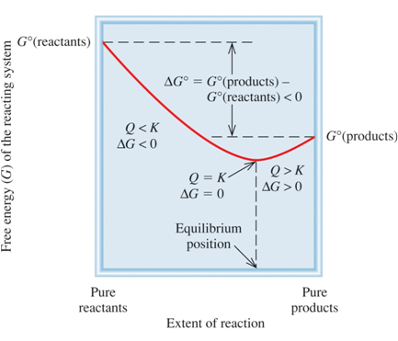
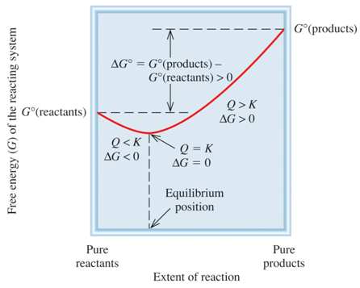
Free Energy and Equilibrium
At equilibrium:
ΔG° = -R T ln K
At any time:
ΔG = ΔG° + R T ln Q
ΔG⁰ < 0
ΔG⁰ > 0

Slide 26
Chapter 17

Slide 27
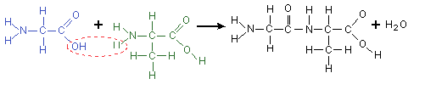
“Uphill” Reactions
Synthesis of proteins: (first step)
alanine + glycine → alanylglycine ΔG° = 29 kJ/mol
Because ΔG > 0, the reaction is non-spontaneous.
alanine
No reaction!
glycine
Need to couple two reactions!

Slide 28
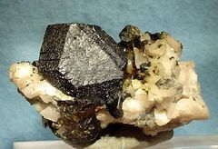
Coupled Reactions
Coupled Reactions- using a thermodynamically favorable (ΔG° < 0) reaction (ΔG° < 0) to drive an unfavorable one (ΔG° > 0) .
Example: Industrial ore separation-
Zinc Metal
Major applications in the US
Galvanizing (55%)
Alloys (21%)
Brass and bronze (16%)
Miscellaneous (8%)
Sphalerite ore
White pigment (ZnO)
Fire retardant (ZnCl₂)
Vitamin supplement (Zn²⁺)
Reducing agent (Zn(s))
We need 2000 tones of the zinc metal per year!

Slide 29

Coupled Reactions
Coupled Reactions- using a thermodynamically favorable (ΔG° < 0) reaction (ΔG° < 0) to drive an unfavorable one (ΔG° > 0) .
Example: Industrial ore separation-
Unfavorable reaction (ΔG° > 0)
95 % of Zinc is produced by this method

Slide 30
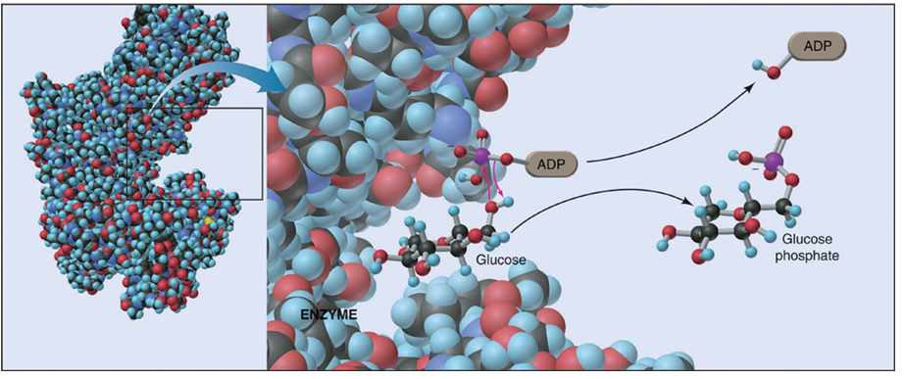
Coupled Reactions in Biology
ΔG° < 0
ΔG° > 0
glucose + Pi → glucose-6-phosphate
ATP + H₂O → ADP + Pi
glucose + ATP → glucose-6-phosphate + ADP

Slide 31
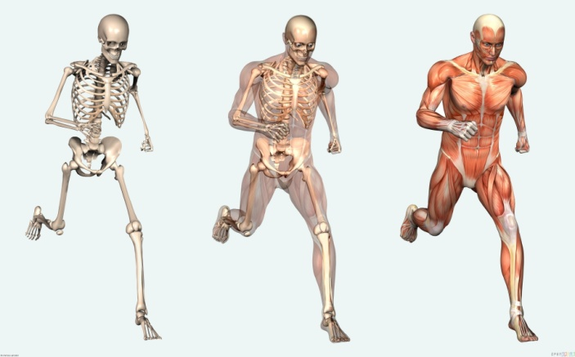
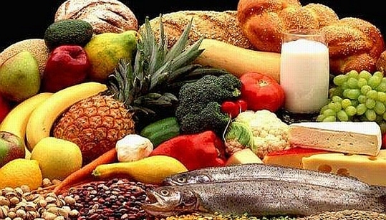
Coupled Reactions in Biology
?
Food
Structural motion and maintenance
Fats and Carbohydrates
Coupled reactions
ATP and NADPH
Chemical Batteries for the Body
Stored bond energy

Slide 32
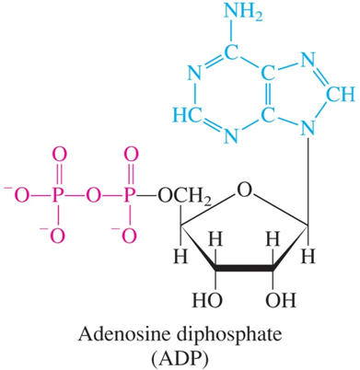
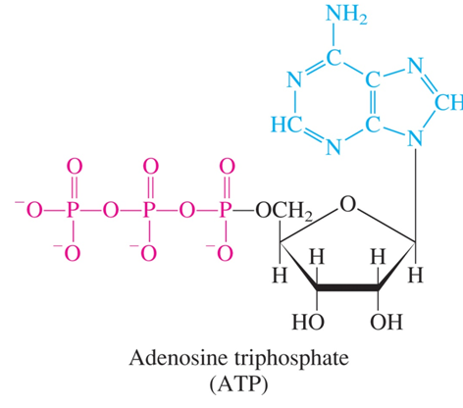
Coupled Reactions in Biology
Digestion/respiration:
Generation of ATP:
Burning Glucose
Low Energy
Higher Energy

Slide 33
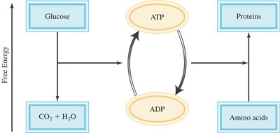
“Uphill” Reactions
Synthesis of proteins: (first step)
alanine + glycine → alanylglycine ΔG° = 29 kJ/mol
ATP + H₂O → ADP + H₃PO₄ ΔG° = -31 kJ/mol
alanine + glycine + ATP + H₂O → alanylglycine + ADP + H₃PO₄ ΔG° = -2 kJ/mol
Spontaneous!

Slide 34
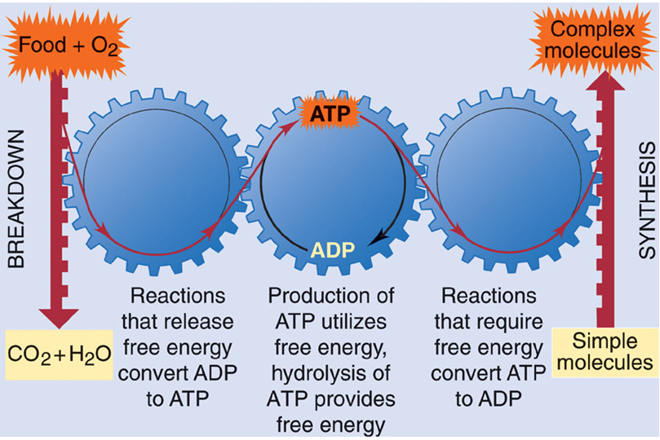
Coupled Reactions in Biology

Slide 35
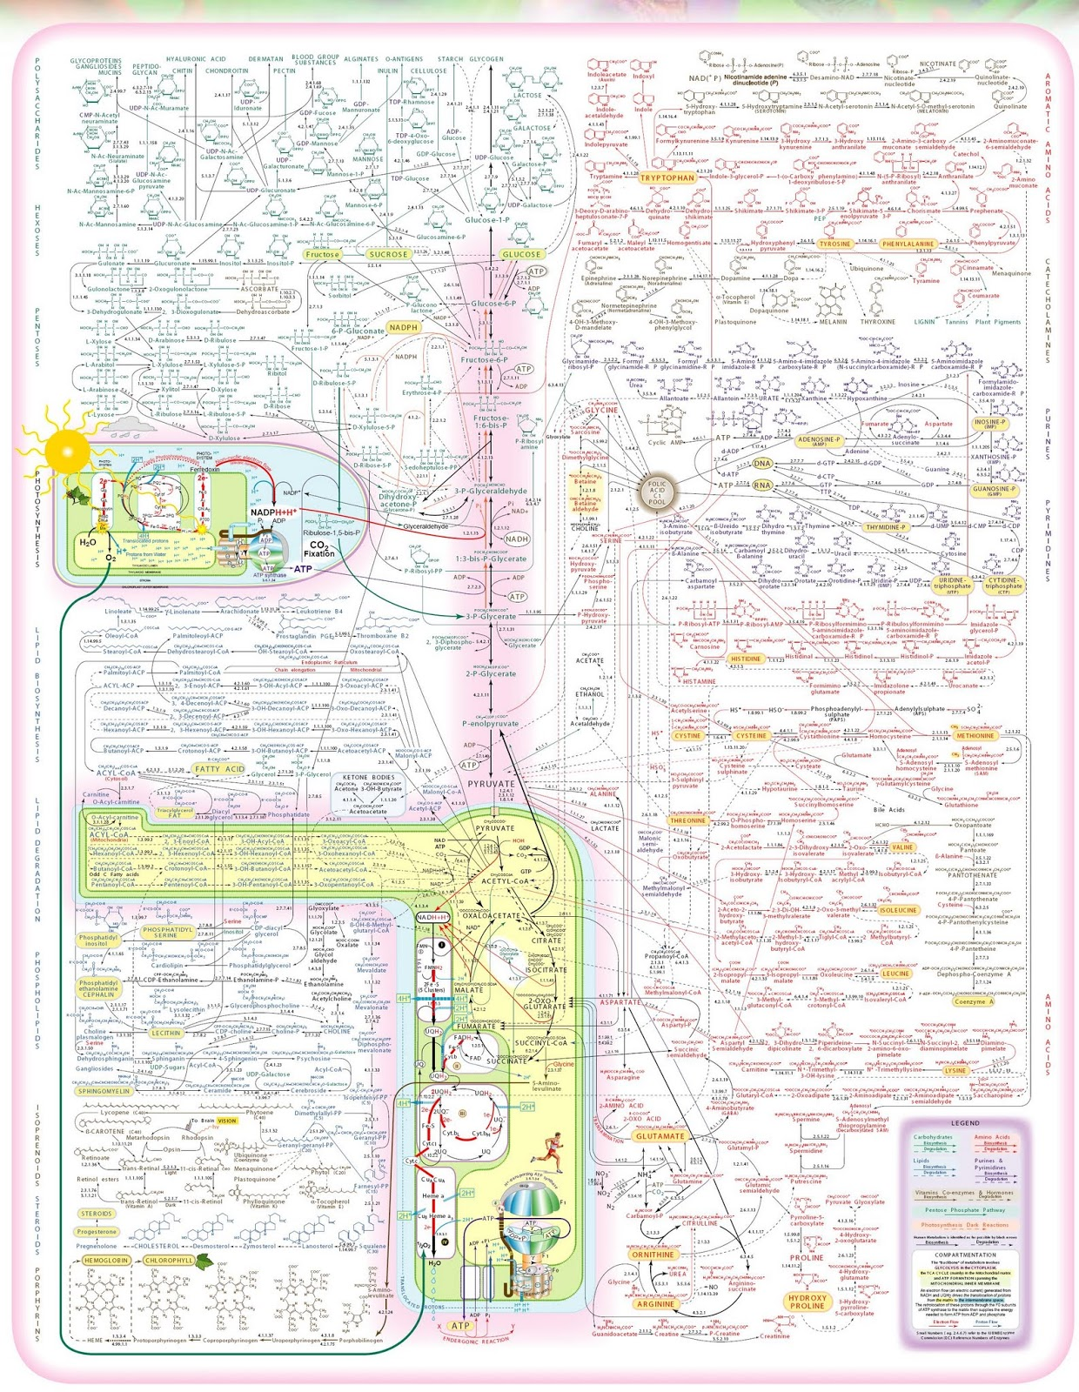
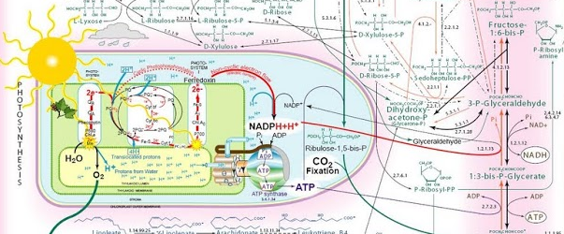
Coupled reactions to drive the synthesis of:
Aminoacids
Ribose
Nucleic acids
Polypeptides
DNA
Phospholipids
This is why we eat!
…and why plants absorb light.

Slide 36
Chapter 17

